Slide 1
What is PL/SQL
PL/SQL - Procedural Language/Structured Query Language.
It is a sophisticated programming language used to access an Oracle database from various environments.
It is integrated with the database server so that the PL/SQL code can be processed quickly and efficiently.
PL/SQL is one of three key programming languages embedded in the Oracle Database, along with SQL itself and Java.

Slide 2
Why PL/SQL
SQL is a fourth generation language e.g.
DELETE FROM students
WHERE major = ‘Nutrition’;
This will delete all students who are majoring in
nutrition from the database.
Java or C++ are third generation languages.
They are more procedural
They implement a step by step algorithm to solve a problem.
Notes:
4th generation – tell what should be done but not how to do it. So the DELETE statement will delete the student, presumably the server will loop through all students in some order and determine the students to delete. The details of this are hidden from us.
3rd Generation e.g. LOOP over each student record
IF this record has major = ‘ Nutrition’ THEN
DELETE this record
ENDIF
ENDLOOP
Advantagesof 4th Generation : - Fairly simple, fewer commands, insulate user from underlying data structures and algorithms.
Advantages 3rd Generation : sometimes the procedural constructs are useful top a desired program.
This is where PL/SQL comes in it combines the power and flexabilility of 4GL with the procedural constructs of 3GL.

Slide 3
Features of PL/SQL
Block Structure
Error Handling
Variables and Types
Conditionals
Looping Constructs
Cursors
Procedures and Functions
Triggers
Packages

Slide 4
Block Structure
Basic Block structure of a PL/SQL Program.
DECLARE
/* declarative section – PL/SQL variables, types, cursors, and local subprograms go here*/
BEGIN
/* Executable Section – procedural and SQL statements go here. This is the main section of the block and the only one that is required*/
EXCEPTION
/* Exception Handling Section – error handling statements go here*/
END;

Slide 5
Block Code Sample
“Hello World”
DECLARE
v_greeting VARCHAR(20) := 'Hello World';
BEGIN
dbms_output.put_line('My first PL/SQL program says '|| v_greeting ||' !');
END;
Notes:
NOTE Before running this you need to set the server output to ON. Otherwise the output does not display!!!

Slide 6
Indentifiers
Identifiers include variables, cursors, types and subprograms.
Identifiers can be made up of letters, numbers, dollar signs, underscores and the hash symbol(#).
All Identifiers must start with a letter.
Maximum length of an identifier is 30 characters.
Identifiers must not be the same as any reserved word.
It is good programming practice to have a consistent naming scheme for identifiers.
Notes:
For list of Oracle Pl/SQL reserved word list go to :
http://download-west.oracle.com/docs/cd/B19306_01/appdev.102/b14261/reservewords.htm

Slide 7
Delimiters
Delimiters are symbols that have a special meaning to PL/SQL.
They are used to separate identifiers from each other.
Some common delimiters we will see are:
<< Begin label >> End Label
+ Addition, - Subtraction, / Division, * Multiplication
< Less Than, > Greater Than, = Equality, := Assignment
% Attribute indicator, @ database link indicator
; Statement terminator,
Notes:
For list of PL/SQL delimiters go to :
http://www.java2s.com/Tutorial/Oracle/0480__PL-SQL-Programming/Delimiters.htm

Slide 8
Using % Type
We use variables regularly to manipulate the data stored in the database table.
When using a variable the variable type should be the same as the type as the table column.
E.g. The first_name column of the students table has type VARCHAR(20) so our variable would be declared like this:
V_FirstName VARCHAR(20);
This will work fine BUT what happens if the definition of First_Name is changed in the database??
Notes:
If the definition is changed then the variable needs to be changed to reflect this. Even if the length of the VARCAHR Is the only thing that is cahnged i.e. if the column changes to first_name VARCHAR(25) our variable above needs to be changed to: V_FirstName VARCHAR(25);

Slide 9
Using % Type
If you have a lot of PL/SQL code this changing of code could be very time consuming therefore we need a way to get around this.
Instead of hard coding in the type we can use the %TYPE Attribute.
This attribute is appended to a table column reference, or other variable, and returns its type.
E.g. v_FirstName students.first_name%TYPE;
By using the %TYPE v_FirstName will have whatever the type of the first _name column of the students table has.

Slide 10
PL/SQL Control Structures
PL/SQL like any other third Generation language has control structures that allow you to control the behaviour of the block as it runs.
These include Conditional statements and loops.
It is these structures together with variables that give PL/SQL its power and flexibility.

Slide 11
IF-THEN-ELSE
Basic Syntax is:
IF boolean-expression1 THEN
sequence of statements;
[ELSIF boolean-expression2 THEN
sequence of statements;]
……
[ELSE
sequence of statements;]
END IF;
Notes:
Where boolean expression is any expression that evealuates to a boolean value.
The ELSIF and ELSE clauses are optional, and there can be as many ELSIF cluses as desired.

Slide 12
CASE
If you have a block of code that continually tests a single variable you can re-write this using the CASE statement.
The CASE statement in PL/SQL is similar to the one in Java
See examples following:
Notes:
Must have oracle 9i or higher to use CASE

Slide 13
LOOPS
This is PL/SQLs facility for executing statements repeatedly.
Loops are divided into 4 categories:
Simple Loops – we will cover here
WHILE Loops – we will cover here
Numeric FOR Loops – not covered on this course
Cursor FOR Loops – covered in section on Cursors

Slide 14
Simple Loops
Basic Syntax:
LOOP
sequence of statements;
EXIT [WHEN condition]
END LOOP;

Slide 15
While Loops
Basic Syntax:
WHILE condition LOOP
sequence of statements;
END LOOP;
Notes:
In this case the condition is evaluated before each iteration of the loop. If it evaluates to TRUE the sequence of statements is executed. Id it evaluates to FALSE or NULL the loop is finished and control resumes after the END LOOP statement.

Slide 16
%ROWTYPE
We have seen how to declare a variable with the same type as is in the database using %TYPE
%ROWTYPE is similar, however this allows you to declare a record with the same types as a database row.
For Example
DECLARE
V_RoomRecord rooms%ROWTYPE;
This will define a record whose fields correspond to the columns in the rooms table. So specifically V_RoomRecord would look like this:
(room_id NUMBER(5),
building VARCHAR(15),
room_number NUMBER(4);
number_seats NUMBER(4),
description VARCHAR(50))
Notes:
As with %TYPE, any not NULL constraint defined on the column is not included
. However the length of VARCAHR2 and CHAR columns and the precision and scale for NUMBER columns are included.
If the talbe definition changfes, %ROWTYPE changes along with it.

Slide 17
EXAMPLES
Please see the following slides for code samples of :
IF
Case
LOOPs

Slide 18
IF-THEN-ELSE Example
DECLARE
v_NumberSeats rooms.number_seats%TYPE;
v_Comment VARCHAR2(35);
BEGIN
/* Retrieve the number of seats in the room identified by ID 20008.
Store the result in v_NumberSeats. */
SELECT number seats
INTO v_NumberSeats
FROM rooms
WHERE room_id = 20008;
IF v_NumberSeats < 50 THEN
v_Comment := 'Fairly small';
ELSIF v_NumberSeats < 100 THEN
v_Comment := 'A little bigger';
ELSE
v_Comment := 'Lots of room';
END IF;
dbms_output.put_line(V_Comment);
END;
/
Notes:
PROMPT room_sequence...
DROP SEQUENCE room_sequence;
CREATE SEQUENCE room_sequence
START WITH 20000
INCREMENT BY 1;
PROMPT rooms table...
DROP TABLE rooms CASCADE CONSTRAINTS;
CREATE TABLE rooms (
room_id NUMBER(5) PRIMARY KEY,
building VARCHAR2(15),
room_number NUMBER(4),
number_seats NUMBER(4),
description VARCHAR2(50)
);
INSERT INTO rooms (room_id, building, room_number, number_seats,
description)
VALUES (room_sequence.NEXTVAL, 'Building 7', 201, 1000,
'Large Lecture Hall');
INSERT INTO rooms (room_id, building, room_number, number_seats,
description)
VALUES (room_sequence.NEXTVAL, 'Building 6', 101, 500,
'Small Lecture Hall');
INSERT INTO rooms (room_id, building, room_number, number_seats,
description)
VALUES (room_sequence.NEXTVAL, 'Building 6', 150, 50,
'Discussion Room A');
INSERT INTO rooms (room_id, building, room_number, number_seats,
description)
VALUES (room_sequence.NEXTVAL, 'Building 6', 160, 50,
'Discussion Room B');
INSERT INTO rooms (room_id, building, room_number, number_seats,
description)
VALUES (room_sequence.NEXTVAL, 'Building 6', 170, 50,
'Discussion Room C');
INSERT INTO rooms (room_id, building, room_number, number_seats,
description)
VALUES (room_sequence.NEXTVAL, 'Music Building', 100, 10,
'Music Practice Room');
INSERT INTO rooms (room_id, building, room_number, number_seats,
description)
VALUES (room_sequence.NEXTVAL, 'Music Building', 200, 1000,
'Concert Room');
INSERT INTO rooms (room_id, building, room_number, number_seats,
description)
VALUES (room_sequence.NEXTVAL, 'Building 7', 300, 75,
'Discussion Room D');
INSERT INTO rooms (room_id, building, room_number, number_seats,
description)
VALUES (room_sequence.NEXTVAL, 'Building 7', 310, 50,
'Discussion Room E');

Slide 19
IF-THEN-ELSE Example
DECLARE
v_NumberSeats rooms.number_seats%TYPE;
v_Comment VARCHAR2(35);
BEGIN
/* Retrieve the number of seats in the room identified by ID 20008.
Store the result in v_NumberSeats. */
SELECT number_seats
INTO v_NumberSeats
FROM rooms
WHERE room_id = 20008;
IF v_NumberSeats < 50 THEN
v_Comment := 'Fairly small';
INSERT INTO temp_table (char_col)
VALUES ('Nice and cozy');
ELSIF v_NumberSeats < 100 THEN
v_Comment := 'A little bigger';
INSERT INTO temp_table (char_col)
VALUES ('Some breathing room');
ELSE
v_Comment := 'Lots of room';
END IF;
END;
/
Notes:
Temp Table
PROMPT temp_table...
DROP TABLE temp_table;
CREATE TABLE temp_table (
num_col NUMBER,
char_col VARCHAR2(60)
);
This example just shows that more then one event can occurin the else if ‘s

Slide 20
CASE
This is the same code using CASE:
DECLARE
v_Major students.major%TYPE;
v_CourseName VARCHAR2(10);
BEGIN -- Retrieve the major for a given student
SELECT major
INTO v_Major
FROM students
WHERE ID = 10011; -- Based on the major, choose a course
CASE v_Major
WHEN 'Computer Science' THEN
v_CourseName := 'CS 101';
WHEN 'Economics' THEN
v_CourseName :='ECN 203';
WHEN 'History' THEN
v_CourseName := 'HIS 101';
WHEN 'Music' THEN
v_CourseName := 'MUS 100';
WHEN 'Nutrition' THEN
v_CourseName := 'NUT 307';
ELSE
v_CourseName := 'Unknown';
END CASE;
DBMS_OUTPUT.PUT_LINE(v_CourseName);
END;
/
Notes:
When you have a CASE statement where there is no matching case found you get an error. You can use the ELSE RAISE CASE_NOT_FOUND; it is the equivalent to ELSE and tells the system what to do when no case is matched. See code example below:
DECLARE
v_TestVar NUMBER := 1;
BEGIN
-- Since none of the WHEN clauses tests for the value 1,
-- this will raise ORA-6592.
CASE v_TestVar
WHEN 2 THEN DBMS_OUTPUT.PUT_LINE('Two!');
WHEN 3 THEN DBMS_OUTPUT.PUT_LINE('Three!');
WHEN 4 THEN DBMS_OUTPUT.PUT_LINE('Four!');
END CASE;
END;
/
You can label CASE statements << MyCase>> on the line before you start your case declaration.

Slide 21
Simple Loop Example
DECLARE
v_Counter BINARY_INTEGER := 1;
BEGIN
LOOP
-- Insert a row into temp_table with the current value of the
-- loop counter.
INSERT INTO temp_table
VALUES (v_Counter, 'Loop index');
v_Counter := v_Counter + 1;
-- Exit condition - when the loop counter > 50 we will
-- break out of the loop.
IF v_Counter > 50 THEN
EXIT;
END IF;
END LOOP;
END;
/
Notes:
WE can change the exit line to the following:
EXIT WHEN v_Counter > 50;

Slide 22
While Loops Example
DECLARE
v_Counter BINARY_INTEGER := 1;
BEGIN
-- Test the loop counter before each loop iteration to
-- insure that it is still less than 50.
WHILE v_Counter <= 50 LOOP
INSERT INTO temp_table
VALUES (v_Counter, 'Loop index');
v_Counter := v_Counter + 1;
END LOOP;
END;
/

Slide 23
PL/SQL Records Example
DECLARE
-- Define a record to match some fields in the students table.
-- Note the use of %TYPE for the fields.
TYPE t_StudentRecord IS RECORD (
FirstName students.first_name%TYPE,
LastName students.last_name%TYPE,
Major students.major%TYPE);
-- Declare a variable to receive the data.
v_Student t_StudentRecord;
BEGIN
-- Retrieve information about student with ID 10,000.
-- Note how the query is returning columns which match the
-- fields in v_Student.
SELECT first_name, last_name, major
INTO v_Student
FROM students
WHERE ID = 10000;
END;
/
Notes:
Oracle 9i and higher also allows records to be used in INSERT and UPDATE statements, in order to modify data in the database as opposed to just querying it.

Slide 24
What is a Cursor?
A Cursor is a pointer or handle to the context area.
When processing an SQL statement Oracle allocates an area of memory called the context area.
This context area contains information necessary to complete the processing, including the number of rows processed by the statement, a pointer to the parsed representation of the statement and in the case of a query, the active set – which is the set of rows returned by the query.

Slide 25
What is a Cursor?
Through the Cursor the PL/SQL program can control the context area, and what happens to it as the statement is processed.
There are four steps needed for explicit Cursor processing:
Declare the cursor.
Open the cursor for a query.
Fetch the results into PL/SQL variables.
Close the cursor.

Slide 26
Declaring a Cursor
This step involves naming the cursor and associating it with a SELECT statement.
The syntax is:
CURSOR cursor_name IS select_statement
cursor-name – is the name of the cursor
select_statement – is the query to be processed by this cursor.
A cursor name is a PL/SQL identifier and must be declared before being referenced (Recall: rules for naming identifiers).
A Cursor declaration can reference PL/SQL variables as well.
Notes:
Identifiers include variables, cursors, types and subprograms.
Identifiers can be made up of letters, numbers, dollar signs, underscores and the hash symbol(#).
All Identifiers must start with a letter.
Maximum length of an identifier is 30 characters.
Identifiers must not be the same as any reserved word.
It is good programming practice to have a consistent naming scheme for identifiers.

Slide 27
Declaration of Cursor Example
DECLARE
v_department classes.department%TYPE;
v_course classes.course%TYPE;
CURSOR c_classes IS
SELECT * from classes
WHERE department = v_department
AND Course = v_course;

Slide 28
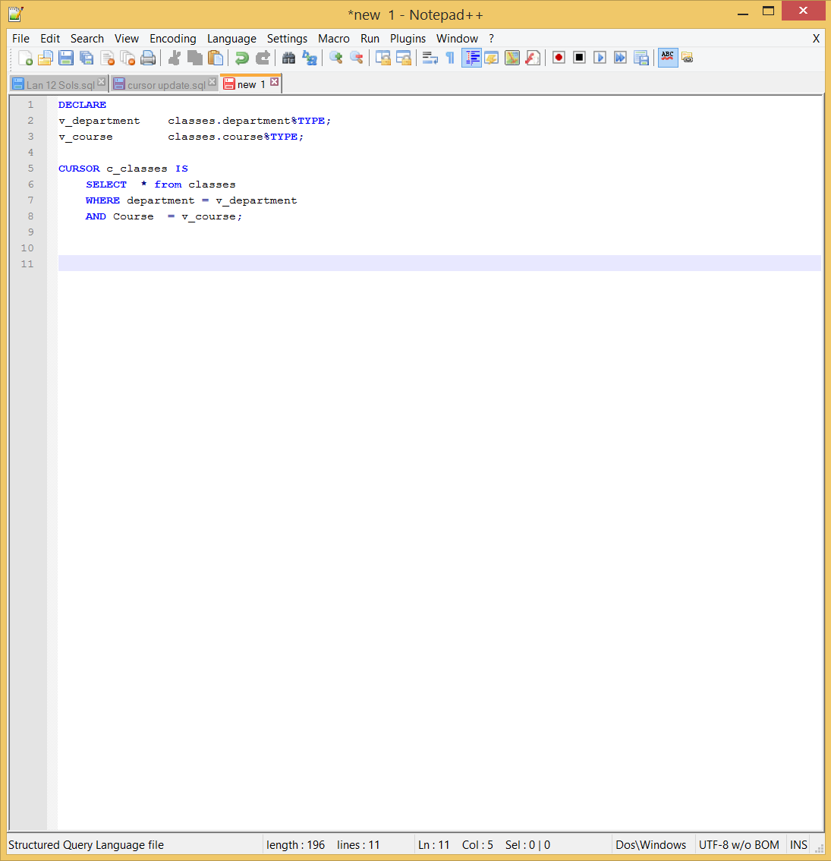
Declaration of Cursor Example

Slide 29
Opening a Cursor
The syntax for opening a cursor is:
OPEN cursor_name;
Where cursor_name identifies a cursor that has previously been declared.
When a cursor is open the following happens
The values of the bind variable are examined
Based on the values of the bind variables and the contents of the tables referenced in the query, the active set is determined.
The active set pointer is set to the first row

Slide 30
Open Cursor Example
DECLARE
v_StudentID students.ID%TYPE;
CURSOR c_AllStudentIDs IS
SELECT ID FROM students;
BEGIN
OPEN c_AllStudentIDs;
END;

Slide 31
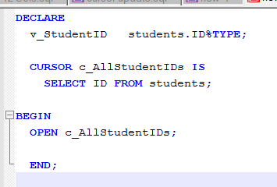
Open Cursor Example

Slide 32
Open Cursor Example Error
DECLARE
v_StudentID students.ID%TYPE;
CURSOR c_AllStudentIDs IS
SELECT ID FROM students;
BEGIN
OPEN c_AllStudentIDs;
-- Open it again. This will raise ORA-6511.
OPEN c_AllStudentIDs;
END;

Slide 33
Fetching from a Cursor
The INTO clause for a query is part of the FETCH statement.
The FETCH has two forms:
FETCH cursor_name INTO list_of_variables
AND
FETCH cursor_name INTO PL/SQL record
In either case the variable(s) in the INTO clause must be compatible with the Select list of the query.

Slide 34
Fetch into PL/SQL record
DECLARE
v_classesRecord classes%rowtype;
CURSOR c_AllClasses IS
SELECT *
FROM classes;
BEGIN
OPEN c_AllClasses;
FETCH c_AllClasses INTO v_ClassesRecord;
END;

Slide 35
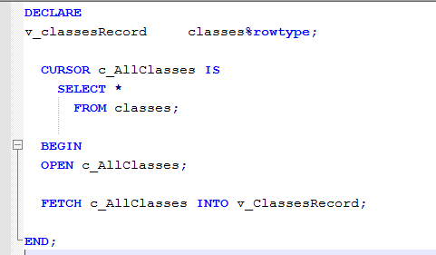
Fetch into PL/SQL record

Slide 36
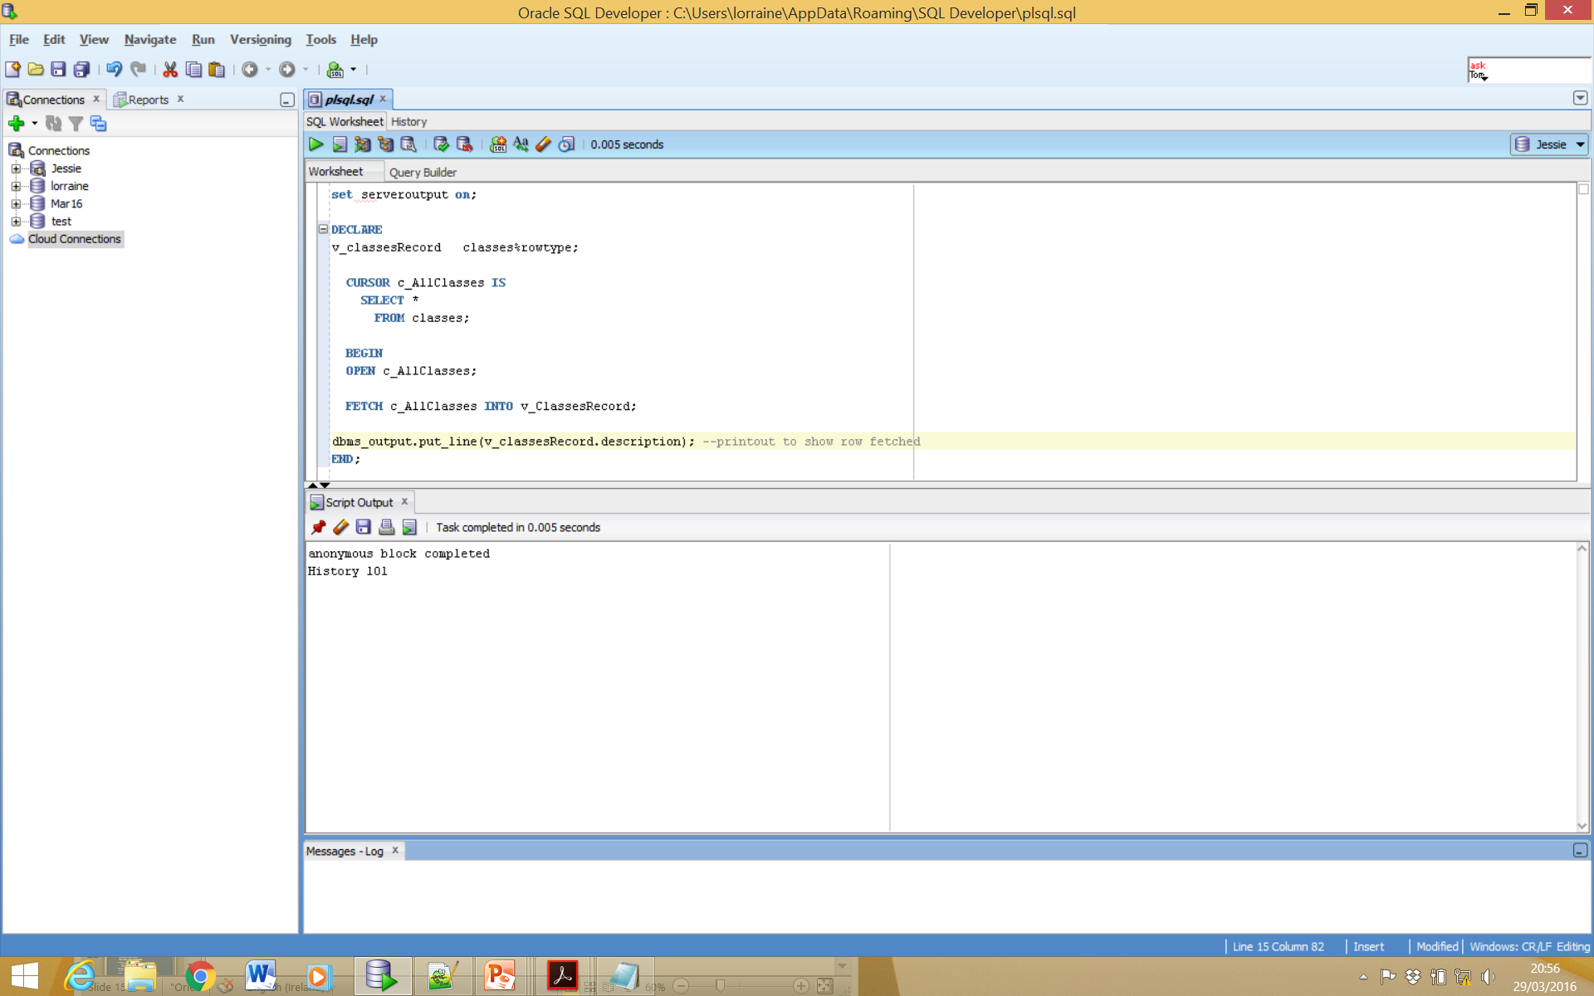
Fetch showing 1st resulting row

Slide 37
Bad Fetch
DECLARE
TYPE v_classesRecord IS RECORD
( v_Department classes.department%TYPE,
v_Course classes.course%TYPE);
CURSOR c_AllClasses IS
SELECT *
FROM classes;
BEGIN
OPEN c_AllClasses;
FETCH c_AllClasses INTO v_ClassesRecord;
END;
Notes:
Bad Fetch -- This FETCH statement is illegal, since the select list of the query returns all 7 columns in the classes table but we are only fetching into 2 variables. This will raise the error "PLS-00321: expression 'V_CLASSESRECORD' is inappropriate as the left hand side of an assignment statement

Slide 38
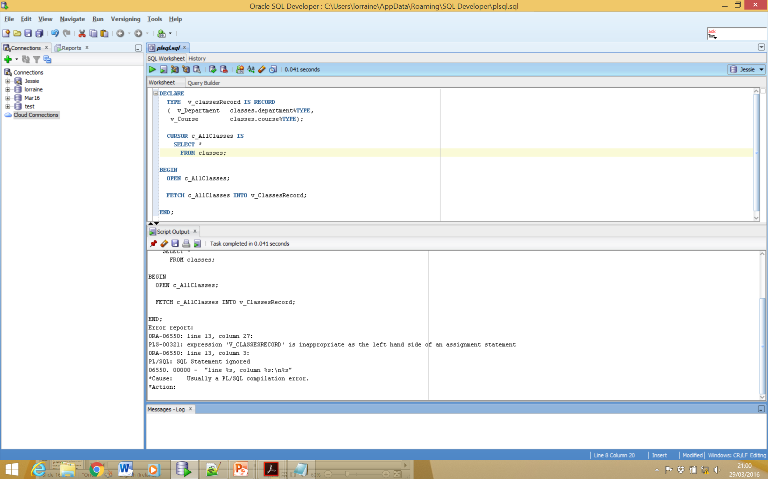
Bad Fetch

Slide 39
Closing a Cursor
When all the active set has been retrieved the cursor should be closed.
This lets the PL/SQL know that the program is finished with the cursor and the resources associated with the cursor can be freed.
Syntax for close cursor is
CLOSE cursor_name;
Where cursor_name identifies a previously opened cursor. Once closed it is illegal to fetch from a cursor. Doing so will result in an Oracle error.

Slide 40
Close Cursor
DECLARE
v_classesRecord classes%rowtype;
CURSOR c_AllClasses IS
SELECT *
FROM classes;
BEGIN
OPEN c_AllClasses;
FETCH c_AllClasses INTO v_ClassesRecord;
CLOSE c_AllClasses;
END;

Slide 41
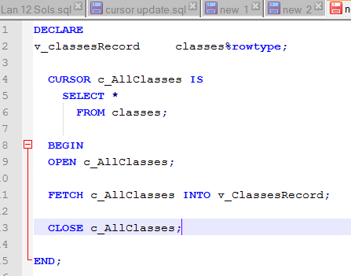
Close Cursor

Slide 42
Controlling Cursor
No
DECLARE
OPEN
FETCH
Yes
CLOSE
EMPTY?
Create a named SQL area
Identify the active set
Load the current row into variables
Test for existing rows
Release the active set
Return to FETCH if rows found

Slide 43
Cursor Attributes
Obtain status information about a cursor.
Attribute Type Description
%ISOPEN Boolean Evaluates to TRUE if the cursor is open
%NOTFOUND Boolean Evaluates to TRUE if the most recent fetch does not return a row
%FOUND Boolean Evaluates to TRUE if the most recent fetch returns a row; complement of %NOTFOUND
%ROWCOUNT Number Evaluates to the total number of rows returned so far

Slide 44
25463
12245
55983
12524
98543
Create or replace procedure proc_test as
v_empid number;
Cursor cur_sample is
Select empid from employee
where grade > 4;
Begin
open cur_sample;
loop
fetch cur_sample into v_empid;
exit when cur_sample%notfound;
update employee
set salary = salary + 500
where empid = v_empid;
end loop;
End;
Data returned by cursor
Declare Cursor
Open cursor for use.
Loops round each value
returned by the cursor
Place the value from the cursor into the variable v_empid
Stop when no more records are found

Slide 45
Cursor Loops
The most common operation with Cursors is to fetch all the rows of the active set.
This is done with a fetch loop.
A fetch loop is simply a loop that processes each of the rows in the active set one-by-one.
Simple, While & FOR are all valid cursor loops.

Slide 46
Simple Cursor Loop
Declare variables to hold information about the students majoring in History.
DECLARE
v_StudentID students.id%TYPE;
v_FirstName students.first_name%TYPE;
v_LastName students.last_name%TYPE;
CURSOR c_HistoryStudents IS
SELECT id, first_name, last_name
FROM students
WHERE major = 'History';
BEGIN
OPEN c_HistoryStudents;
LOOP
FETCH c_HistoryStudents INTO v_StudentID, v_FirstName, v_LastName;
EXIT WHEN c_HistoryStudents%NOTFOUND;
INSERT INTO registered_students (student_id, department, course)
VALUES (v_StudentID, 'HIS', 301);
INSERT INTO temp_table (num_col, char_col)
VALUES (v_StudentID, v_FirstName || ' ' || v_LastName);
END LOOP;
CLOSE c_HistoryStudents;
END;
Notes:
-- Declare variables to hold information about the students majoring in History.
-- Set up Cursor to retrieve the information about History students
-- Open the cursor and initialize the active set
-- Retrieve information for the next student
-- Exit loop when there are no more rows to fetch
-- Process the fetched rows. In this case sign up each student for History 301 by inserting them into the registered_students table.
-- Record the first and last names in temp_table as well.
-- Free resources used by the cursor
NOTE: The placement of EXIT WHEN immediately after the FETCH statement. After the last row has been retrieved, c_HistoryStudents%NOTFOUND becomes TRUE the loop is exited. The EXIT WHEN statement is also before the processing of the data, this is done to ensure the processing will not have to handle any NULL rows.

Slide 47
Simple Cursor Loop
DECLARE
v_StudentID students.id%TYPE;
v_FirstName students.first_name%TYPE;
v_LastName students.last_name%TYPE;
CURSOR c_HistoryStudents IS
SELECT id, first_name, last_name
FROM students
WHERE major = 'History';
BEGIN
OPEN c_HistoryStudents;
LOOP
FETCH c_HistoryStudents INTO v_StudentID, v_FirstName, v_LastName;
EXIT WHEN c_HistoryStudents%NOTFOUND;
INSERT INTO registered_students (student_id, department, course)
VALUES (v_StudentID, 'HIS', 301);
INSERT INTO temp_table (num_col, char_col)
VALUES (v_StudentID, v_FirstName || ' ' || v_LastName);
END LOOP;
CLOSE c_HistoryStudents;
END;
2. Set up Cursor to retrieve the information about History students
Notes:
-- Declare variables to hold information about the students majoring in History.
-- Set up Cursor to retrieve the information about History students
-- Open the cursor and initialize the active set
-- Retrieve information for the next student
-- Exit loop when there are no more rows to fetch
-- Process the fetched rows. In this case sign up each student for History 301 by inserting them into the registered_students table.
-- Record the first and last names in temp_table as well.
-- Free resources used by the cursor
NOTE: The placement of EXIT WHEN immediately after the FETCH statement. After the last row has been retrieved, c_HistoryStudents%NOTFOUND becomes TRUE the loop is exited. The EXIT WHEN statement is also before the processing of the data, this is done to ensure the processing will not have to handle any NULL rows.

Slide 48
Simple Cursor Loop
DECLARE
v_StudentID students.id%TYPE;
v_FirstName students.first_name%TYPE;
v_LastName students.last_name%TYPE;
CURSOR c_HistoryStudents IS
SELECT id, first_name, last_name
FROM students
WHERE major = 'History';
BEGIN
OPEN c_HistoryStudents;
LOOP
FETCH c_HistoryStudents INTO v_StudentID, v_FirstName, v_LastName;
EXIT WHEN c_HistoryStudents%NOTFOUND;
INSERT INTO registered_students (student_id, department, course)
VALUES (v_StudentID, 'HIS', 301);
INSERT INTO temp_table (num_col, char_col)
VALUES (v_StudentID, v_FirstName || ' ' || v_LastName);
END LOOP;
CLOSE c_HistoryStudents;
END;
3. Open the cursor and initialize the active set
Notes:
-- Declare variables to hold information about the students majoring in History.
-- Set up Cursor to retrieve the information about History students
-- Open the cursor and initialize the active set
-- Retrieve information for the next student
-- Exit loop when there are no more rows to fetch
-- Process the fetched rows. In this case sign up each student for History 301 by inserting them into the registered_students table.
-- Record the first and last names in temp_table as well.
-- Free resources used by the cursor
NOTE: The placement of EXIT WHEN immediately after the FETCH statement. After the last row has been retrieved, c_HistoryStudents%NOTFOUND becomes TRUE the loop is exited. The EXIT WHEN statement is also before the processing of the data, this is done to ensure the processing will not have to handle any NULL rows.

Slide 49
Simple Cursor Loop
DECLARE
v_StudentID students.id%TYPE;
v_FirstName students.first_name%TYPE;
v_LastName students.last_name%TYPE;
CURSOR c_HistoryStudents IS
SELECT id, first_name, last_name
FROM students
WHERE major = 'History';
BEGIN
OPEN c_HistoryStudents;
LOOP
FETCH c_HistoryStudents INTO v_StudentID, v_FirstName, v_LastName;
EXIT WHEN c_HistoryStudents%NOTFOUND;
INSERT INTO registered_students (student_id, department, course)
VALUES (v_StudentID, 'HIS', 301);
INSERT INTO temp_table (num_col, char_col)
VALUES (v_StudentID, v_FirstName || ' ' || v_LastName);
END LOOP;
CLOSE c_HistoryStudents;
END;
4. Retrieve information for the next student
initialize the active set
Notes:
-- Declare variables to hold information about the students majoring in History.
-- Set up Cursor to retrieve the information about History students
-- Open the cursor and initialize the active set
-- Retrieve information for the next student
-- Exit loop when there are no more rows to fetch
-- Process the fetched rows. In this case sign up each student for History 301 by inserting them into the registered_students table.
-- Record the first and last names in temp_table as well.
-- Free resources used by the cursor
NOTE: The placement of EXIT WHEN immediately after the FETCH statement. After the last row has been retrieved, c_HistoryStudents%NOTFOUND becomes TRUE the loop is exited. The EXIT WHEN statement is also before the processing of the data, this is done to ensure the processing will not have to handle any NULL rows.

Slide 50
Simple Cursor Loop
DECLARE
v_StudentID students.id%TYPE;
v_FirstName students.first_name%TYPE;
v_LastName students.last_name%TYPE;
CURSOR c_HistoryStudents IS
SELECT id, first_name, last_name
FROM students
WHERE major = 'History';
BEGIN
OPEN c_HistoryStudents;
LOOP
FETCH c_HistoryStudents INTO v_StudentID, v_FirstName, v_LastName;
EXIT WHEN c_HistoryStudents%NOTFOUND;
INSERT INTO registered_students (student_id, department, course)
VALUES (v_StudentID, 'HIS', 301);
INSERT INTO temp_table (num_col, char_col)
VALUES (v_StudentID, v_FirstName || ' ' || v_LastName);
END LOOP;
CLOSE c_HistoryStudents;
END;
5. Exit loop when there are no more rows to fetch
Notes:
-- Declare variables to hold information about the students majoring in History.
-- Set up Cursor to retrieve the information about History students
-- Open the cursor and initialize the active set
-- Retrieve information for the next student
-- Exit loop when there are no more rows to fetch
-- Process the fetched rows. In this case sign up each student for History 301 by inserting them into the registered_students table.
-- Record the first and last names in temp_table as well.
-- Free resources used by the cursor
NOTE: The placement of EXIT WHEN immediately after the FETCH statement. After the last row has been retrieved, c_HistoryStudents%NOTFOUND becomes TRUE the loop is exited. The EXIT WHEN statement is also before the processing of the data, this is done to ensure the processing will not have to handle any NULL rows.

Slide 51
Simple Cursor Loop
DECLARE
v_StudentID students.id%TYPE;
v_FirstName students.first_name%TYPE;
v_LastName students.last_name%TYPE;
CURSOR c_HistoryStudents IS
SELECT id, first_name, last_name
FROM students
WHERE major = 'History';
BEGIN
OPEN c_HistoryStudents;
LOOP
FETCH c_HistoryStudents INTO v_StudentID, v_FirstName, v_LastName;
EXIT WHEN c_HistoryStudents%NOTFOUND;
INSERT INTO registered_students (student_id, department, course)
VALUES (v_StudentID, 'HIS', 301);
INSERT INTO temp_table (num_col, char_col)
VALUES (v_StudentID, v_FirstName || ' ' || v_LastName);
END LOOP;
CLOSE c_HistoryStudents;
END;
6. Process the fetched rows. In this case sign up each student for History 301 by inserting them into the registered_students table.
Notes:
-- Declare variables to hold information about the students majoring in History.
-- Set up Cursor to retrieve the information about History students
-- Open the cursor and initialize the active set
-- Retrieve information for the next student
-- Exit loop when there are no more rows to fetch
-- Process the fetched rows. In this case sign up each student for History 301 by inserting them into the registered_students table.
-- Record the first and last names in temp_table as well.
-- Free resources used by the cursor
NOTE: The placement of EXIT WHEN immediately after the FETCH statement. After the last row has been retrieved, c_HistoryStudents%NOTFOUND becomes TRUE the loop is exited. The EXIT WHEN statement is also before the processing of the data, this is done to ensure the processing will not have to handle any NULL rows.

Slide 52
Simple Cursor Loop
DECLARE
v_StudentID students.id%TYPE;
v_FirstName students.first_name%TYPE;
v_LastName students.last_name%TYPE;
CURSOR c_HistoryStudents IS
SELECT id, first_name, last_name
FROM students
WHERE major = 'History';
BEGIN
OPEN c_HistoryStudents;
LOOP
FETCH c_HistoryStudents INTO v_StudentID, v_FirstName, v_LastName;
EXIT WHEN c_HistoryStudents%NOTFOUND;
INSERT INTO registered_students (student_id, department, course)
VALUES (v_StudentID, 'HIS', 301);
INSERT INTO temp_table (num_col, char_col)
VALUES (v_StudentID, v_FirstName || ' ' || v_LastName);
END LOOP;
CLOSE c_HistoryStudents;
END;
7. Record the first and last names in temp_table as well.
Notes:
-- Declare variables to hold information about the students majoring in History.
-- Set up Cursor to retrieve the information about History students
-- Open the cursor and initialize the active set
-- Retrieve information for the next student
-- Exit loop when there are no more rows to fetch
-- Process the fetched rows. In this case sign up each student for History 301 by inserting them into the registered_students table.
-- Record the first and last names in temp_table as well.
-- Free resources used by the cursor
NOTE: The placement of EXIT WHEN immediately after the FETCH statement. After the last row has been retrieved, c_HistoryStudents%NOTFOUND becomes TRUE the loop is exited. The EXIT WHEN statement is also before the processing of the data, this is done to ensure the processing will not have to handle any NULL rows.

Slide 53
Simple Cursor Loop
DECLARE
v_StudentID students.id%TYPE;
v_FirstName students.first_name%TYPE;
v_LastName students.last_name%TYPE;
CURSOR c_HistoryStudents IS
SELECT id, first_name, last_name
FROM students
WHERE major = 'History';
BEGIN
OPEN c_HistoryStudents;
LOOP
FETCH c_HistoryStudents INTO v_StudentID, v_FirstName, v_LastName;
EXIT WHEN c_HistoryStudents%NOTFOUND;
INSERT INTO registered_students (student_id, department, course)
VALUES (v_StudentID, 'HIS', 301);
INSERT INTO temp_table (num_col, char_col)
VALUES (v_StudentID, v_FirstName || ' ' || v_LastName);
END LOOP;
CLOSE c_HistoryStudents;
END;
8. Close the Cursor this will free resources used by the cursor
.
Notes:
-- Declare variables to hold information about the students majoring in History.
-- Set up Cursor to retrieve the information about History students
-- Open the cursor and initialize the active set
-- Retrieve information for the next student
-- Exit loop when there are no more rows to fetch
-- Process the fetched rows. In this case sign up each student for History 301 by inserting them into the registered_students table.
-- Record the first and last names in temp_table as well.
-- Free resources used by the cursor
NOTE: The placement of EXIT WHEN immediately after the FETCH statement. After the last row has been retrieved, c_HistoryStudents%NOTFOUND becomes TRUE the loop is exited. The EXIT WHEN statement is also before the processing of the data, this is done to ensure the processing will not have to handle any NULL rows.

Slide 54
Simple Cursor Loop
CURSOR c_HistoryStudents IS
SELECT id, first_name, last_name
FROM students
WHERE major = 'History';
BEGIN
OPEN c_HistoryStudents;
LOOP
FETCH c_HistoryStudents INTO v_StudentID, v_FirstName, v_LastName;
EXIT WHEN c_HistoryStudents%NOTFOUND;
INSERT INTO registered_students (student_id, department, course)
VALUES (v_StudentID, 'HIS', 301);
NOTE: The placement of EXIT WHEN immediately after the FETCH statement. After the last row has been retrieved, c_HistoryStudents%NOTFOUND becomes TRUE the loop is exited.
The EXIT WHEN statement is also before the processing of the data, this is done to ensure the processing will not have to handle any NULL rows.
Notes:
-- Declare variables to hold information about the students majoring in History.
-- Set up Cursor to retrieve the information about History students
-- Open the cursor and initialize the active set
-- Retrieve information for the next student
-- Exit loop when there are no more rows to fetch
-- Process the fetched rows. In this case sign up each student for History 301 by inserting them into the registered_students table.
-- Record the first and last names in temp_table as well.
-- Free resources used by the cursor
NOTE: The placement of EXIT WHEN immediately after the FETCH statement. After the last row has been retrieved, c_HistoryStudents%NOTFOUND becomes TRUE the loop is exited. The EXIT WHEN statement is also before the processing of the data, this is done to ensure the processing will not have to handle any NULL rows.

Slide 55
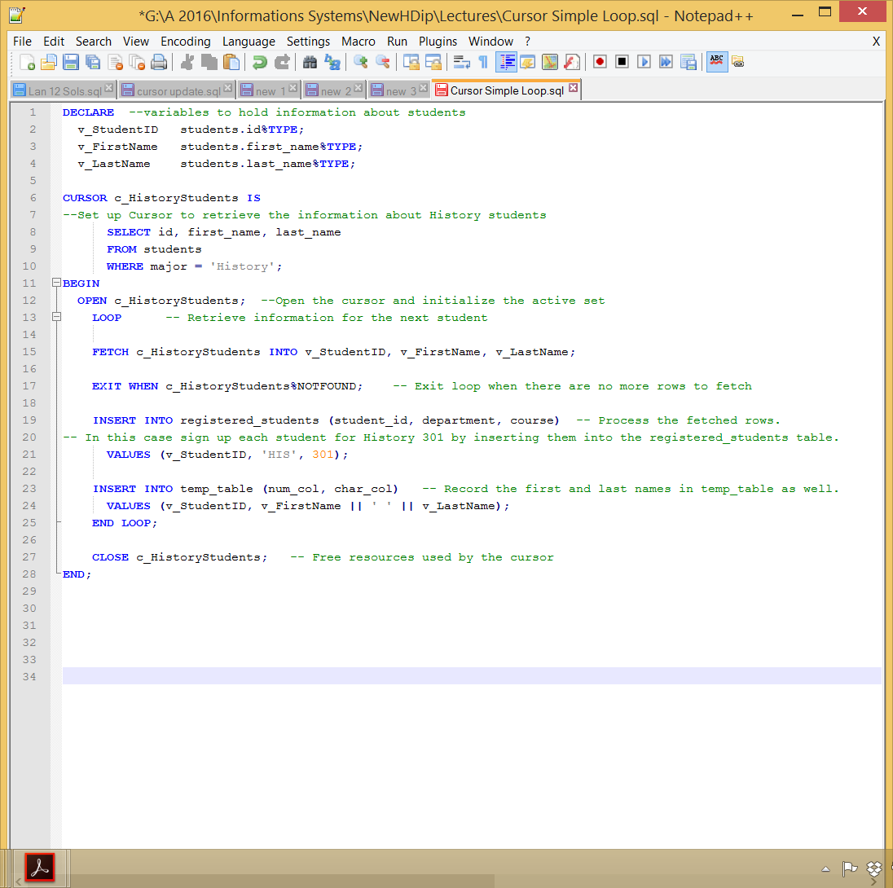
Simple Cursor Loop

Slide 56
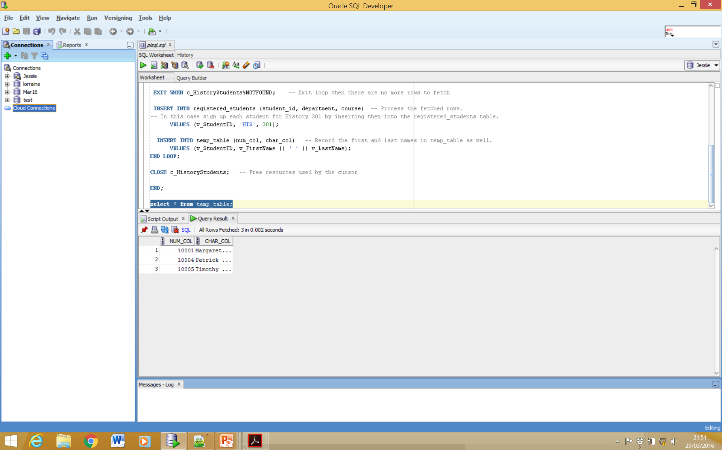
Simple Cursor Loop – Query Result

Slide 57
Simple Cursor Loop – Incorrect Exit
DECLARE
v_StudentID students.id%TYPE;
v_FirstName students.first_name%TYPE;
v_LastName students.last_name%TYPE;
CURSOR c_HistoryStudents IS
SELECT id, first_name, last_name
FROM students
WHERE major = 'History';
BEGIN
OPEN c_HistoryStudents;
LOOP
FETCH c_HistoryStudents INTO v_StudentID, v_FirstName, v_LastName;
INSERT INTO registered_students (student_id, department, course)
VALUES (v_StudentID, 'HIS', 301);
INSERT INTO temp_table (num_col, char_col)
VALUES (v_StudentID, v_FirstName || ' ' || v_LastName);
EXIT WHEN c_HistoryStudents%NOTFOUND; - --If moved to here what happens?
END LOOP;
CLOSE c_HistoryStudents;
END;
Notes:
IF WE move the EXIT WHEN to the new position, the last fetch will not modify the v_StudentID, v_FirstName, v_LastName because there are no more rows in the active set. The output variable will still have the values for the prior fetched rows. Because the check is after the processing this duplicate values are entered into registered_students and temp_students tables. Which is not what we want to happen.

Slide 58
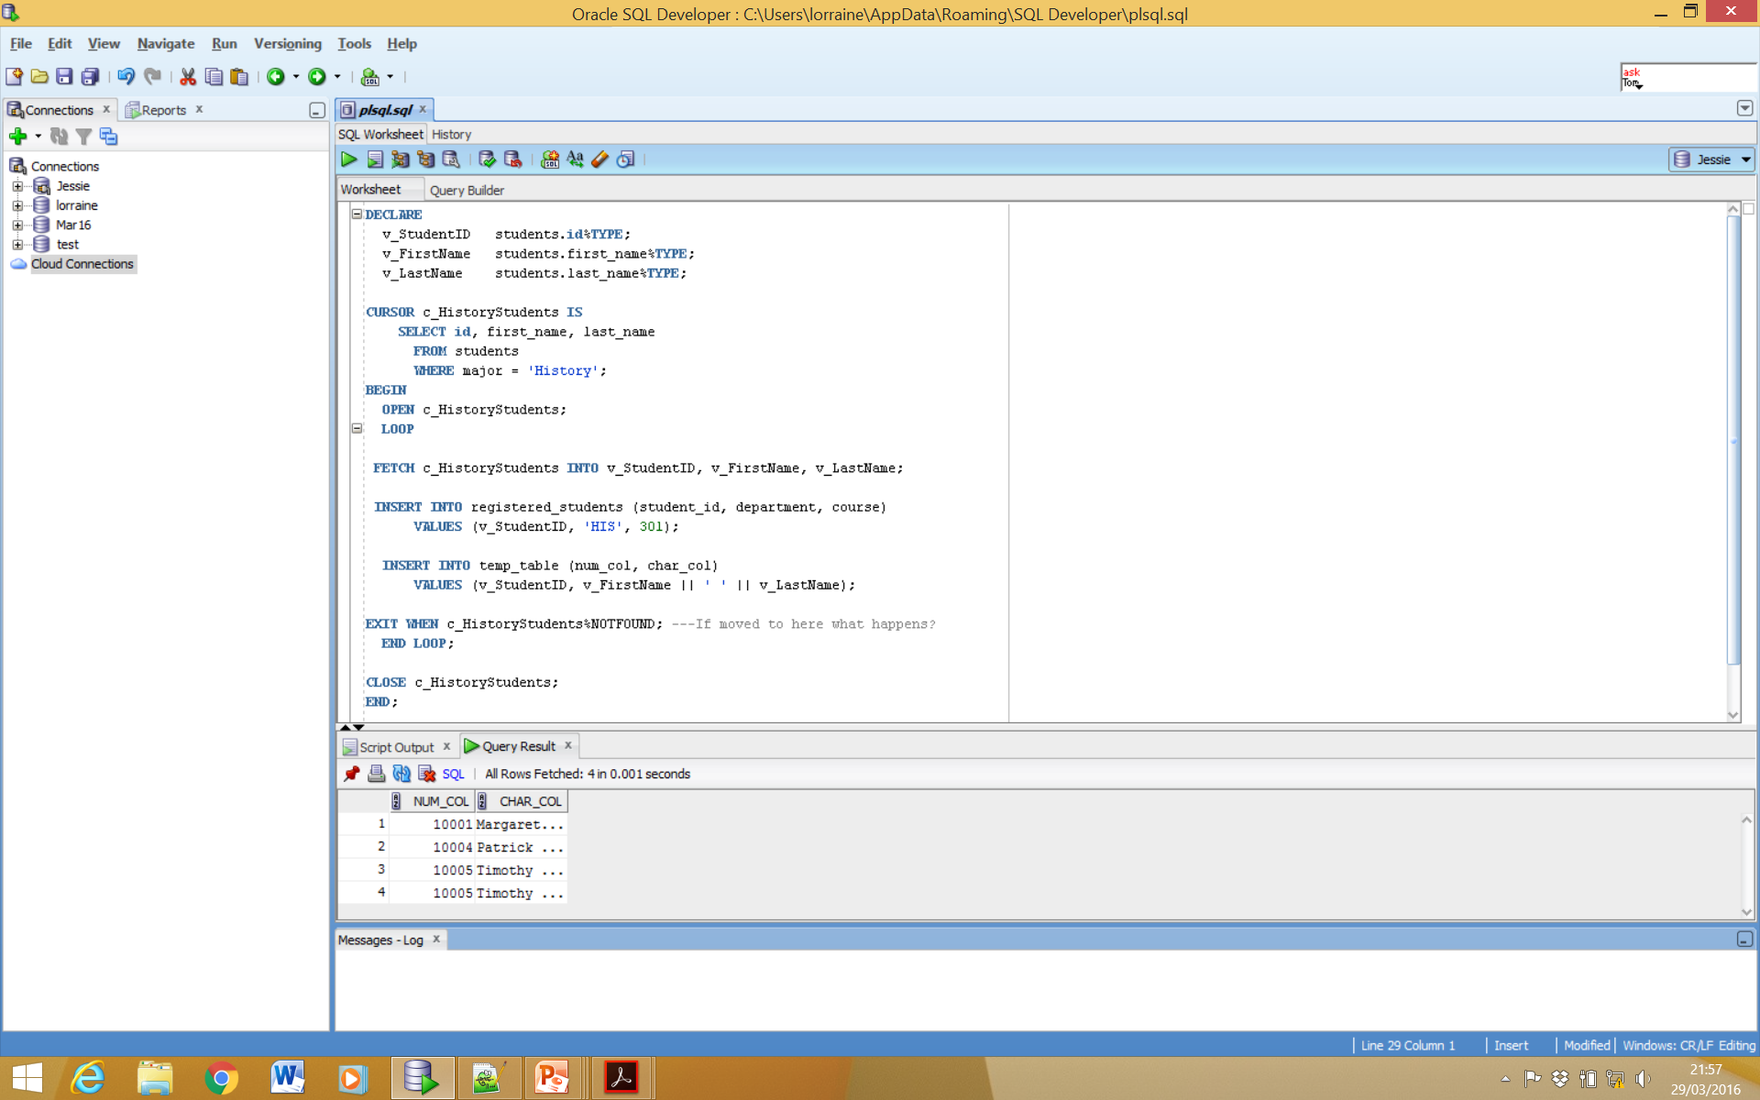
Simple Cursor Loop – Incorrect Exit

Slide 59
While Cursor Loop
DECLARE
CURSOR c_HistoryStudents IS
SELECT id, first_name, last_name
FROM students
WHERE major = 'History';
v_StudentData c_HistoryStudents%ROWTYPE;
BEGIN
OPEN c_HistoryStudents;
FETCH c_HistoryStudents INTO v_StudentData;
WHILE c_HistoryStudents%FOUND LOOP
INSERT INTO registered_students (student_id, department, course)
VALUES (v_StudentData.ID, 'HIS', 301);
INSERT INTO temp_table (num_col, char_col)
VALUES (v_StudentData.ID, v_StudentData.first_name || ' ' || v_StudentData.last_name);
FETCH c_HistoryStudents INTO v_StudentData;
END LOOP;
CLOSE c_HistoryStudents;
END;
Notes:
-- Cursor to retrieve the information about History students
-- Declare a record to hold the fetched information.
-- Open the cursor and initialize the active set
-- Continue looping while there are more rows to fetch Process the fetched rows, in this case sign up each student for History 301 by inserting them into the registered_students table. Record the first and last names in temp_table as well.
-- Retrieve the next row. The %FOUND condition will be checked before the loop continues again.
-- Free resources used by the cursor

Slide 60
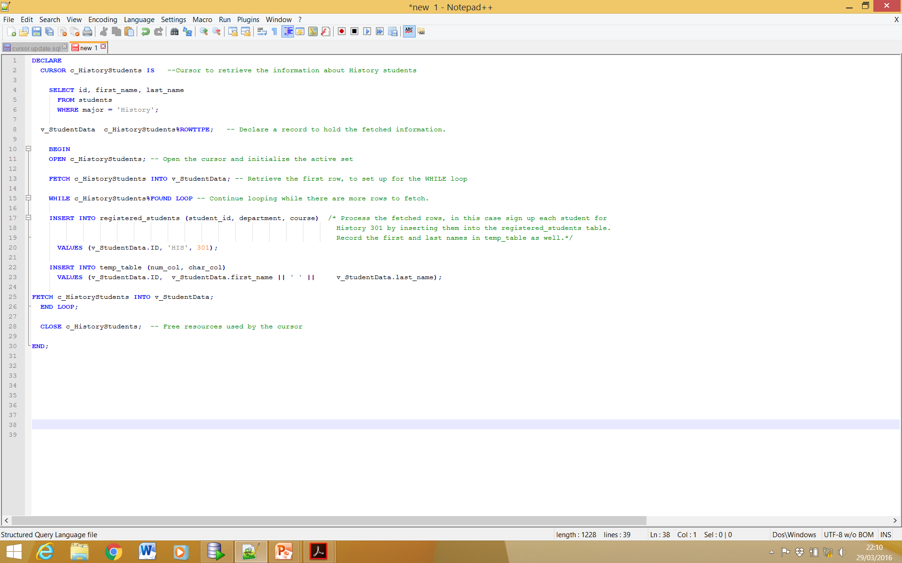
While Cursor Loop

Slide 61
Cursor FOR Loops
The two previous examplesrequire explicit processing of the cursor with OPEN, FETCH and CLOSE statements.
PL/SQL provides a simpler type of loop, which implictly handles the cursor processing
This is the FOR loop.

Slide 62
FOR loop Example
DECLARE
-- Cursor to retrieve the information about History students
CURSOR c_HistoryStudents IS
SELECT id, first_name, last_name
FROM students
WHERE major = 'History';
BEGIN
-- Begin the loop. An implicit OPEN of c_HistoryStudents
-- is done here.
FOR v_StudentData IN c_HistoryStudents LOOP
-- An implicit FETCH is done here.
-- c_HistoryStudents%NOTFOUND is also implicitly checked, to
-- see if we are done fetching.
-- Process the fetched rows, in this case sign up each
-- student for History 301 by inserting them into the
-- registered_students table. Record the first and last
-- names in temp_table as well.
INSERT INTO registered_students (student_id, department, course)
VALUES (v_StudentData.ID, 'HIS', 301);
INSERT INTO temp_table (num_col, char_col)
VALUES (v_StudentData.ID,
v_StudentData.first_name || ' ' || v_StudentData.last_name);
END LOOP;
-- Now that the loop is finished, an implicit CLOSE of
-- c_HistoryStudents is done.
END;
Notes:
Two important things to note about this code:
The record v_studentdata is not declared in the declarative section of the block. The variable is implicitly declared by the Pl/SQL compiler. The type of this variable is c_HistoryStudents%ROWTYPE and the scope of the data is only for the loop itself
The c_HistoryStudents is implicitly opened, fetched from and closed by the loop at the places indicated by the comments.
The for loop has the advantage of providing the functionality of a cursor fetch loop cleanly, simply with minimum of syntax.

Slide 63
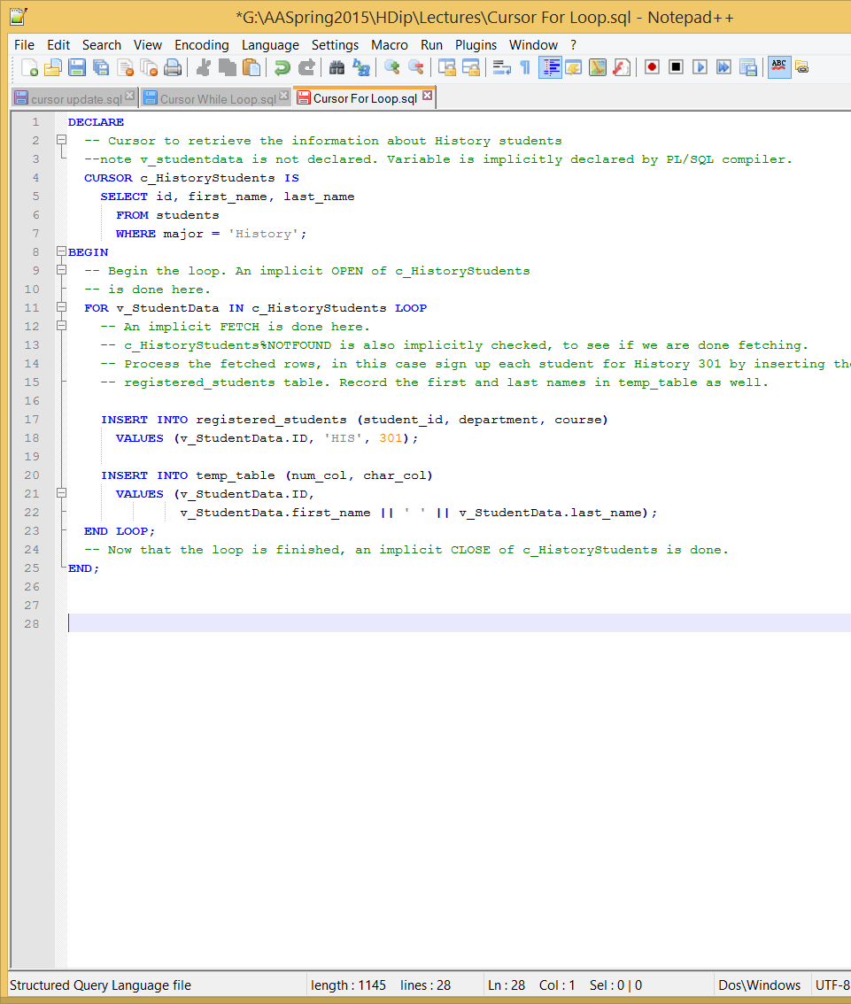
FOR loop Example

Slide 64
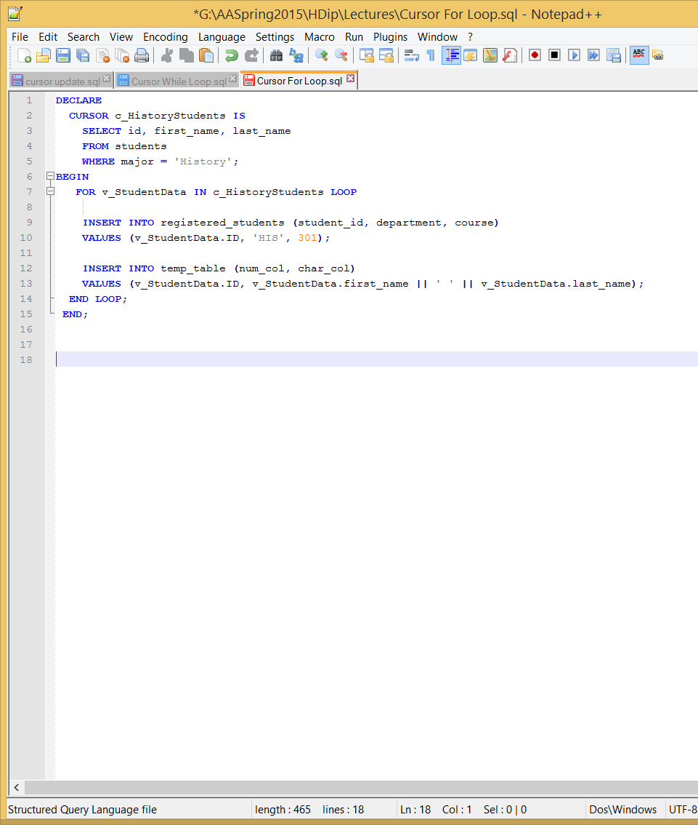
FOR loop Example (Without Comments)
The for loop has the advantage of providing the functionality of a cursor fetch loop cleanly, simply with minimum of syntax.

Slide 65
SELECT FOR UPDATE Cursors
Mostly the processing done in a fetch loop modifies the rows that have been retrieved by the cursor.
PL/SQL provides a convenient syntax for doing this.
There are two parts:
FOR UPDATE clause in the cursor declaration
WHERE CURRENT OF clause in the UPDATE/DELETE statement

Slide 66
FOR UPDATE
The FOR UPDATE clause is part of a SELECT statement.
It is legal as the last clause of a Statement after the ORDER BY(if present).
Syntax:
SELECT...FROM...FOR UPDATEOF [col_ref] [NOWAIT]
Where the col_ref is a column in the table against which the query is performed. A list of columns can also be used e.g. FOR UPDATE first_name, Last_name;

Slide 67
WHERE CURRENT OF
If the cursor is declared with the FOR UPDATE clause the WHERE CURRENT OF clause can be used in an UPDATE or DELETE statement.
Syntax:
WHERE CURRENT OF cursor;
Where the cursor is the name of the cursor that has been declared with a FOR UPDATE clause.
The WHERE CURRENT OF evaluates to the row that was just retrieved by the cursor.
Notes:
NOTES: the update statement updates only the column listed in the FOR UPDATE clause. PL/SQL will allow you update any column in the table even if it is not mentioned in the FOR UPDATE clause, however this is bad practice.
It is illegal to use WHERE CURRENT OF on a cursor that does not have a FOR UPDATE declared

Slide 68
EXAMPLE
DECLARE
v_NumCredits classes.num_credits%TYPE;
CURSOR c_RegisteredStudents IS
SELECT *
FROM students
WHERE id IN (SELECT student_id
FROM registered_students
WHERE department= 'HIS'
AND course = 101)
FOR UPDATE OF current_credits;
BEGIN
FOR v_StudentInfo IN c_RegisteredStudents LOOP
SELECT num_credits
INTO v_NumCredits
FROM classes
WHERE department = 'HIS'
AND course = 101;
UPDATE students
SET current_credits = current_credits + v_NumCredits
WHERE CURRENT OF c_RegisteredStudents;
END LOOP;
COMMIT;
END;
When we are updating data in a table the database prevents access to this data from any other source. To notify the database we are finished with the data we use the COMMIT keyword. This will release the data and also ensure our updates are added to the database.
Notes:
Variable -- Number of credits to add to each student's total
Cursor -- This cursor will select only those students who are currently registered for HIS 101.
LOOP - -- Set up the cursor fetch loop.
SELECT -- Determine the number of credits for HIS 101.
UPDATE -- Update the row we just retrieved from the cursor.
COMMIT -- Commit our work, and release the lock.

Slide 69
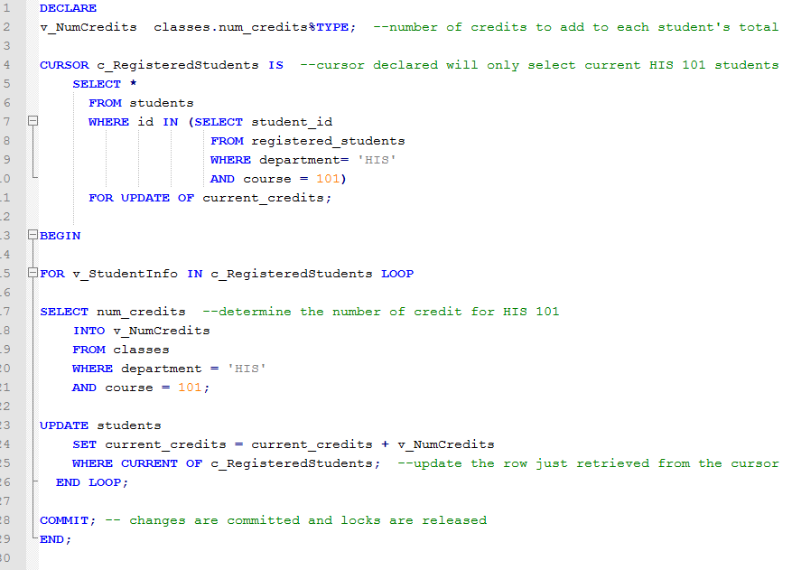
EXAMPLE

Slide 70
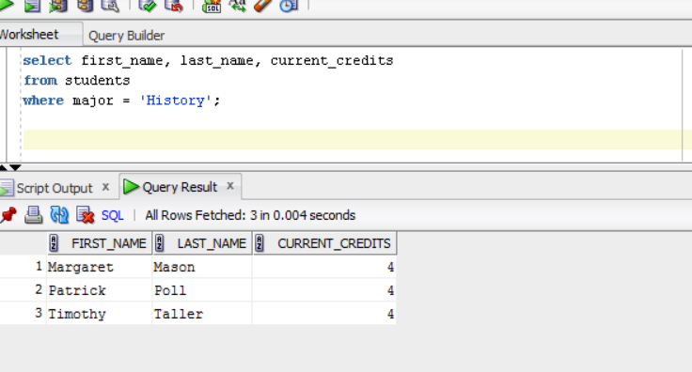
EXAMPLE –before update

